Slide 1
Pemrograman Berbasis Sensor Global Positioning System
Materi Tambahan: Android Sensors : GPS
Roy Ch

Slide 2
Satelite
At any given time, there are at least 24 active satellites orbiting over 12,000 miles above earth.
The positions of the satellites are constructed in a way that the sky above your location will always contain at most 12 satellites.
These visible satellites could transmit information back to earth over radio frequency (ranging from 1.1 to 1.5 GHz).

Slide 3
Trilateration (min 3 satelit)
The first satellite send you signal to let you know your distance from it which means that you are somewhere on the orange circle.
The next satellite reached send you another signal and this let you know that you are somewhere between two meeting point of the orange and green circle.
you
The third satellite reached will finally tell your true position.

Slide 4
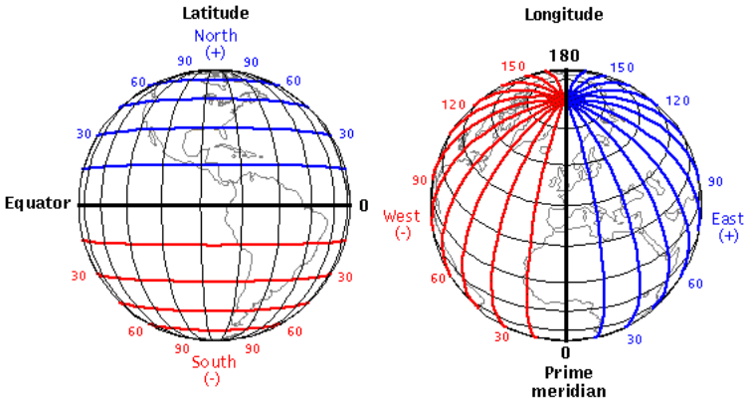
Latitude and Longitude
Jawa :
Latitude : South (-)
Longitude : East (+)
http://www.esar.edu.pt/galeriabe/picture.php?/194

Slide 5
Data GPS
Beberapa format standard (NEMA) untuk data GPS :
GPGGA (Fix Information): Includes position fix, altitude, timestamp, and satellite metadata.
GPGLL (Geographic Latitude/Longitude): Includes position fix and timestamp.
GPRMC (Recommended Minimum Navigation): Includes position fix, speed, timestamp, and navigation metadata.
Example :
$GPGGA,235317.000,4003.9039,N,10512.5793,W,1,08,1.6,1577.9,M,-20.7,M,,0000*5F
Time: 235317.000 is 23:53 and 17.000 seconds in Greenwich mean time
Longitude: 4003.9040,N is latitude in degrees.decimal minutes, north
Latitude: 10512.5792,W is longitude in degrees.decimal minutes, west
Number of satellites seen: 08
Altitude: 1577 meters
https://learn.sparkfun.com/tutorials/gps-basics#the-basics-of-gps

Slide 6
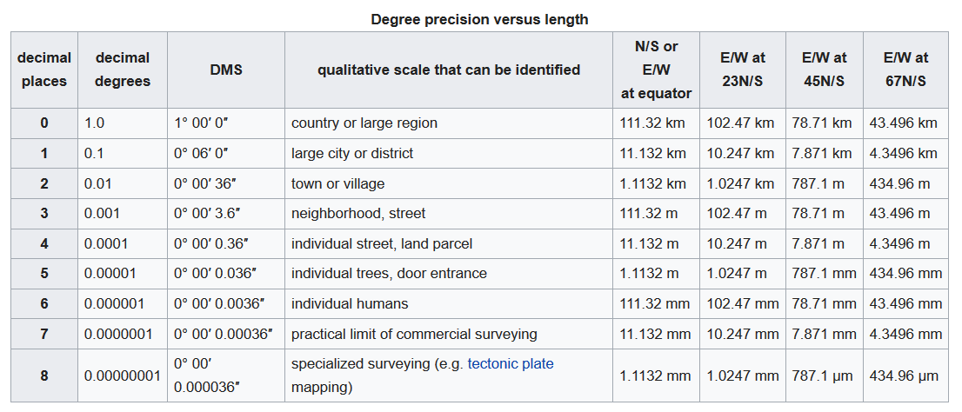
Distance estimation based on GPS
https://en.wikipedia.org/wiki/Decimal_degrees

Slide 7
Simple Aplication
Mengambil dan menampilkan data GPS
Tools : mittApp Inventor

Slide 8
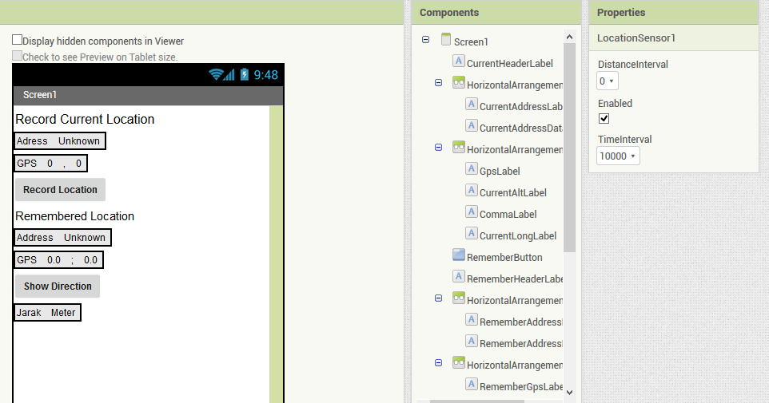
Designer Part :

Slide 9
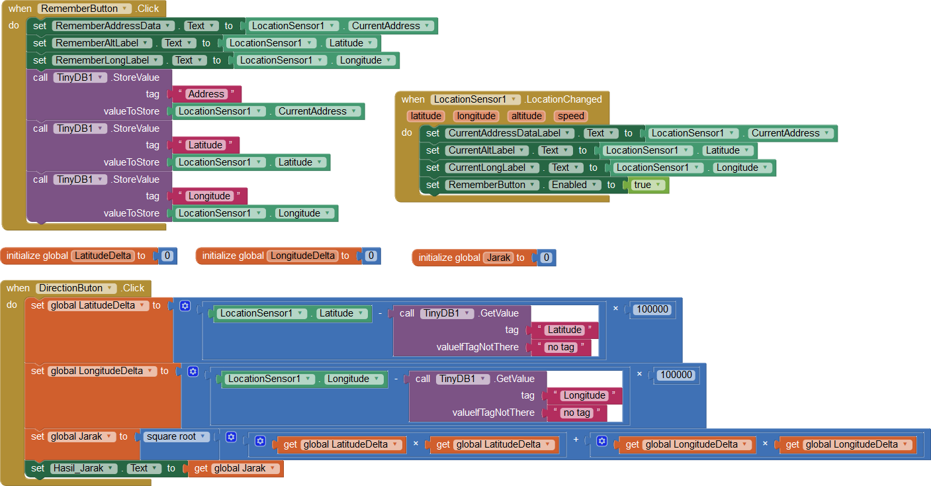
Programing Blocks

Slide 10
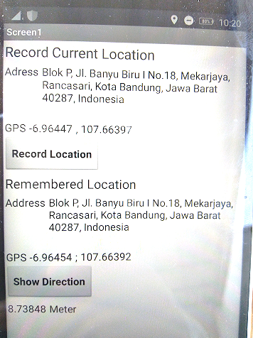
Posisi akhir
Posisi awal
Jarak

